Slide 1
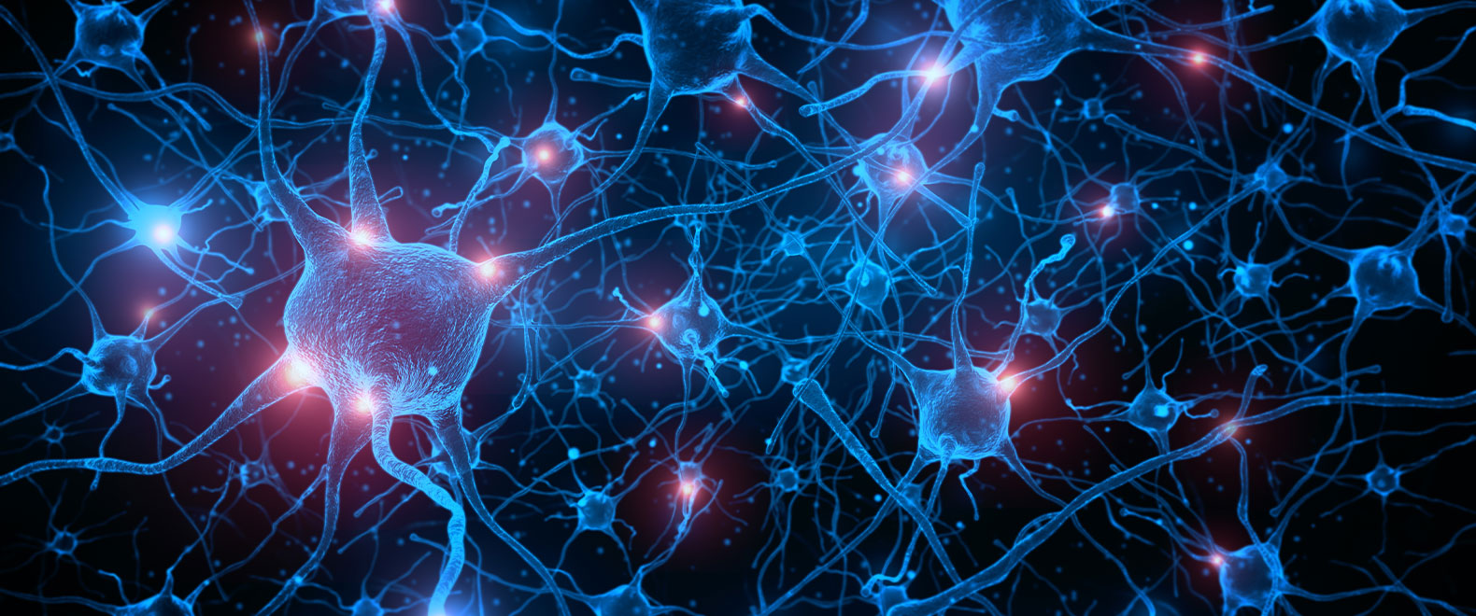
Design Training to Enable Neural Circuits to Accept and Retain New Learning without Resistance
“You’re not perceiving what’s out there. You’re perceiving whatever your brain tells you.” David Eagleman Incognito pg 33.
Sharon-Drew Morgen
Innovator, inventor, thought leader, original thinker, NYTimes Business Bestselling author.
sharondrew@sharondrewmorgen.com www.sharon-drew.com
©Sharon Drew Morgen 2024

Slide 2
What you’ll learn today
What stands in the way of retention/understanding?
How do brains receive/translate incoming content?
The brain elements involved in learning; how to intentionally generate them.
What is Learning Facilitation? Hint: First generate neural circuits to house new content.
Room set-up/exercise & questionnaire creation
©Sharon Drew Morgen 2024

Slide 3
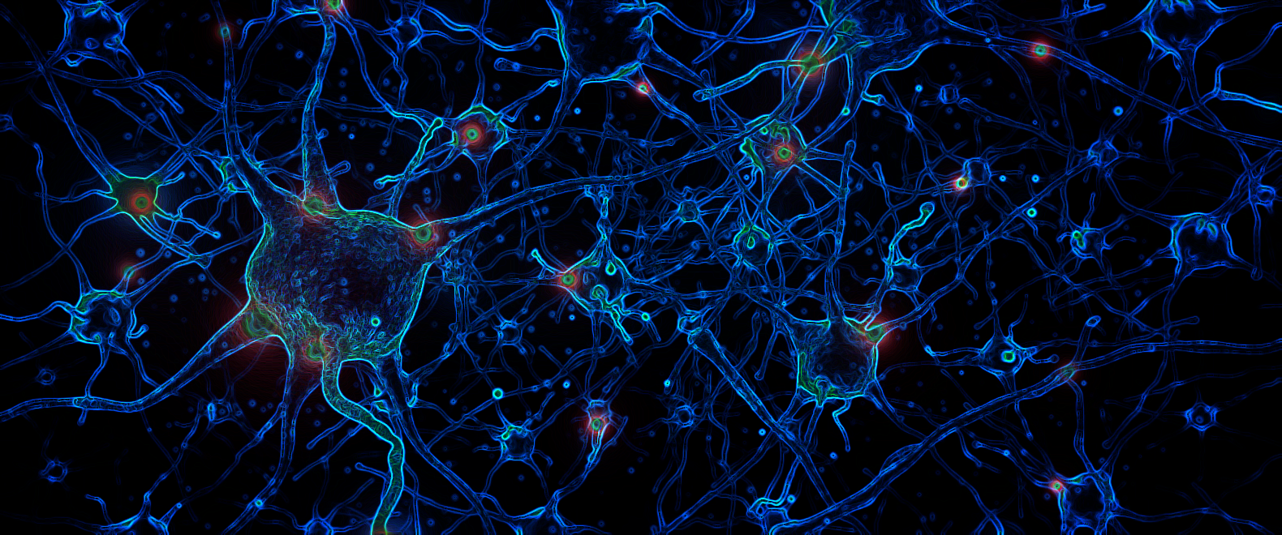

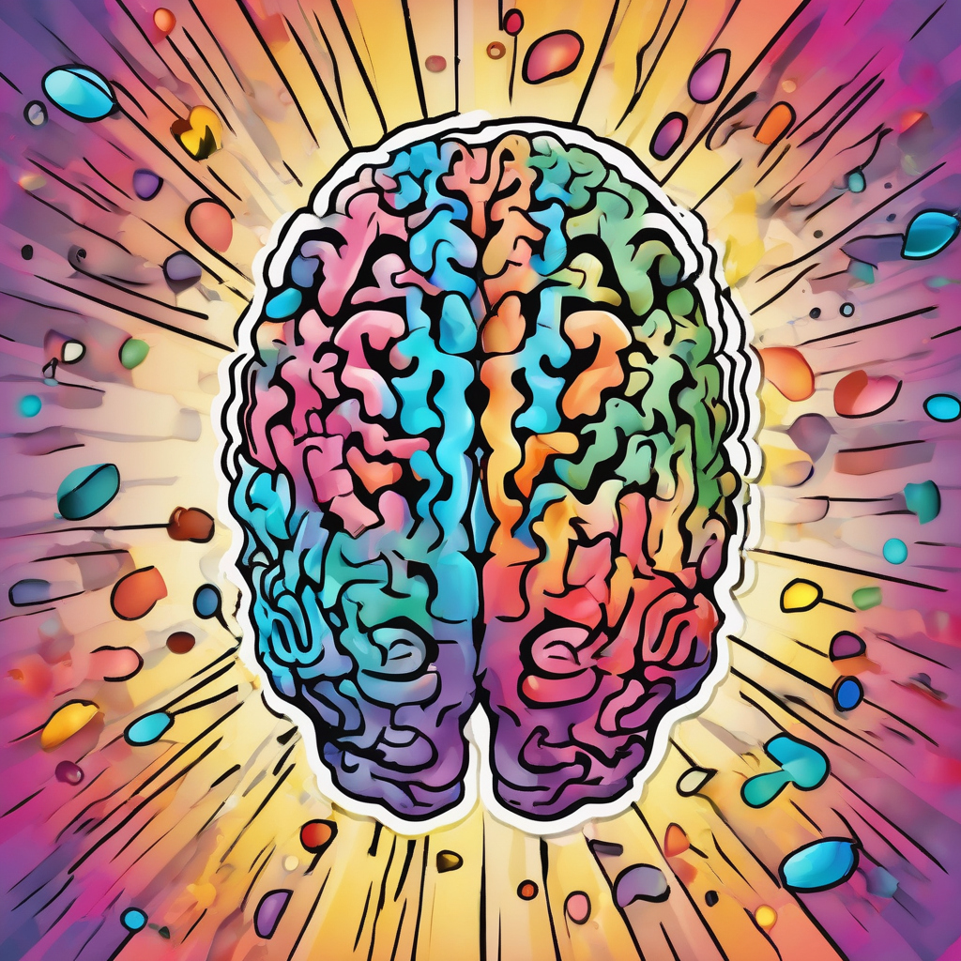
Why teach the brain first?
Avoid natural unconscious biases, assumptions, history and resistance.
Generate new neural circuits to house, retain the new content.
MIND BRAIN
- Misunderstanding - Circuits
- Bias - Neural Connections
- Assumptions - Signal dispatch
- Automatic, habituated - Electrochemical
- Belief-based - Meaningless
©Sharon Drew Morgen 2024

Slide 4
What is listening?
Listening is an automatic, biological, electrochemical, physiological, mechanical process during which spoken words, as meaningless incoming puffs of air, eventually get translated into meaning via existing neural circuitry. This means we can only understand some unknown fraction of what a Speaker intends - and even this is biased by what we already know and have circuits to translate.
©Sharon Drew Morgen 2024

Slide 5
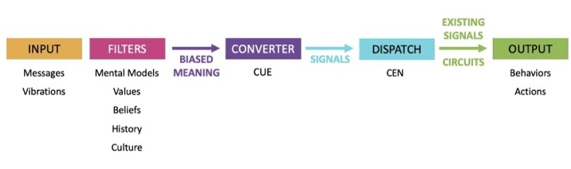
How Brains Listen
©Sharon Drew Morgen 2019

Slide 6
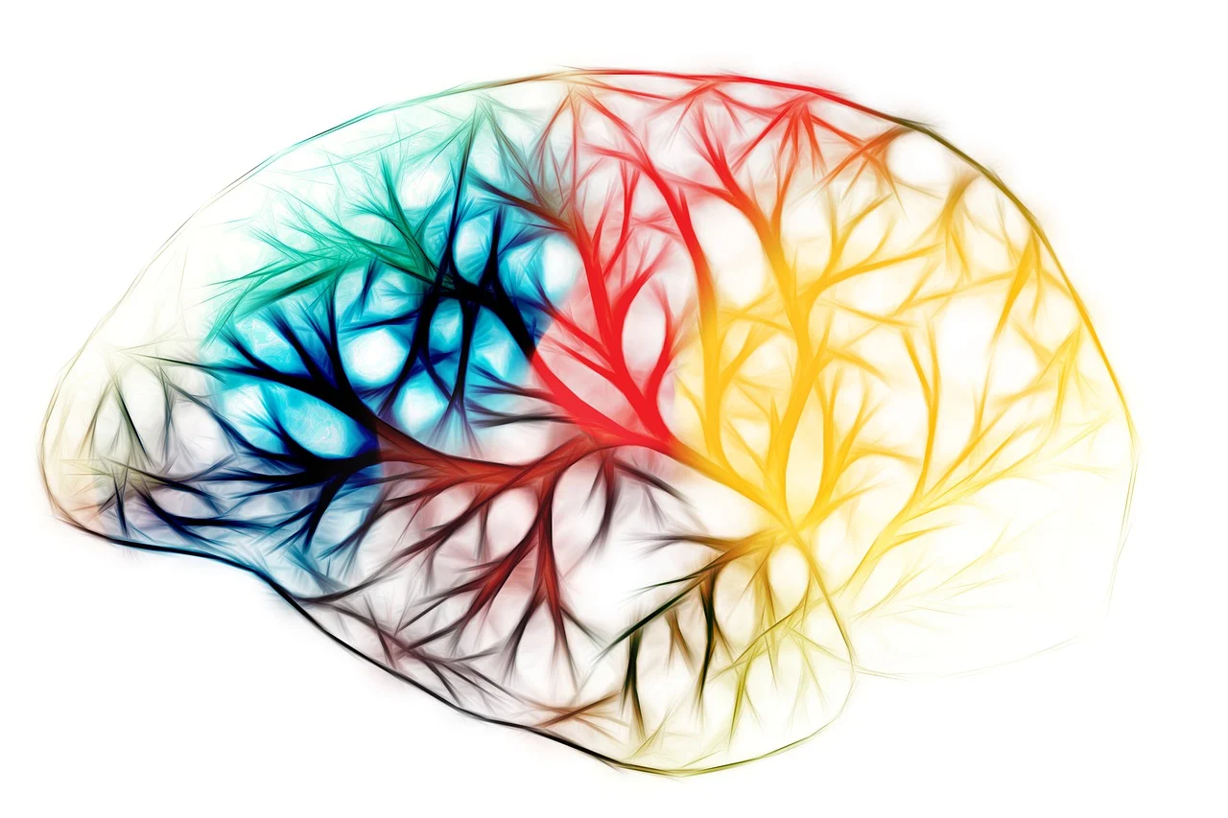
How Brains Bias Incoming Content
1/500ths second
unconscious
mechanical
automatic
unconscious physiological
idiosyncratic
electrochemical
meaningless
misunderstand
habituated
bias
assumptions
reject
mistranslation
What do Learners hear us say?
©Sharon Drew Morgen 2024

Slide 7
To Change/Learn a Behavior
(In)congruence check
Manage risk
Match beliefs
Relevant knowledge input
©Sharon Drew Morgen 2024

Slide 8
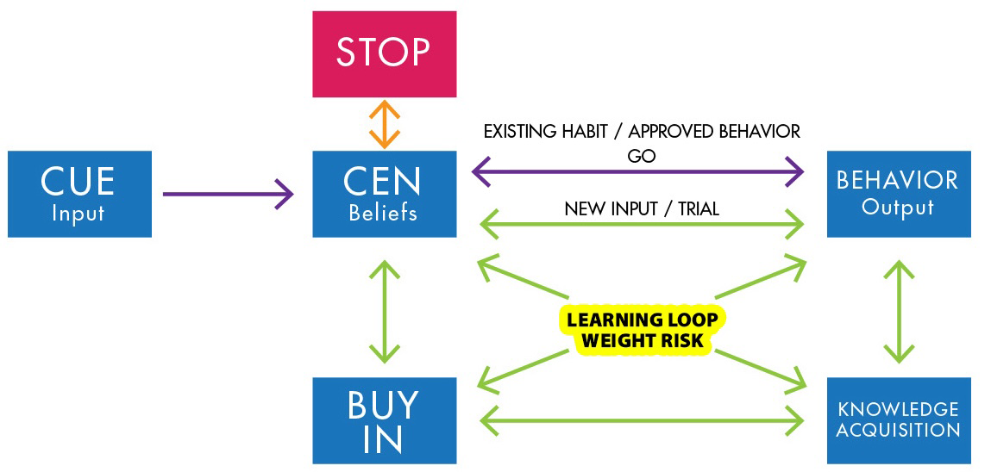
Learning Loop
©Sharon Drew Morgen 2019

Slide 9
Elements in Iterative Learning Loop
Beliefs: Match values. Avoid risk. Discover incongruences. Compare against status quo.
Knowledge acquisition: New content/Input for new circuit creation (reading, videos, etc.)
Trial/fail/stop: Practice new behaviors. Check against existing beliefs. Try/fail until succeed or stop.
Buy-in: Congruence check to match beliefs or rejection/resistance.
Behavior: New circuits formed and integrated. Content retained. Output generated.
©Sharon Drew Morgen 2024

Slide 10
What is Learning Facilitation?
A training competence used before standard training that:
  isolates the brain/bypasses the mind before content delivery
  avoids automatic associations, opinions, bias and comparisons
  uses unique room set up, instructions, exercises and questionnaires
  installs new neural circuits to house/retain new content
  accurately translates new/incoming content
  retains knowledge permanently
©Sharon Drew Morgen 2024

Slide 11
The Learning Facilitation Environment Learners
recognize unconscious incongruences
get directly to unconscious brain circuits where action generated electrochemically
consciously generate new neural circuits
populate with the new knowledge
confusion/failure are features to override existing assumptions, patterns
avoid delivering program content initially: short procedural lectures until circuits formed
broad exercise instructions to encourage natural patterns, incongruence to emerge
initially, questions may not be answered to avoid current biases
©Sharon Drew Morgen 2024

Slide 12
The Learning Facilitation Environment
Instructional Design
Overrides the mind to avoid direct line to thinking, comparing, assumptions
Room set up to bypass existing circuitry, associations, comparisons, assumptions, bias
Omit:
  notes, introductions, information-based lectures, computers, paper, pen
  answering questions/presenting new content until new circuits present
Introduce exercises broadly (not specifically) to:
  induce emergence of existing patterns without bias
  discover unconscious, existing patterns that might impair understanding
  cause confusion
  enable unconscious -> conscious; discover incongruence
  generate circuits to house new content, understand, retain, retrieve.
Use questionnaires to prompt circuit generation: general and objective
  override existing circuits and discover unconscious incongruence and drivers
©Sharon Drew Morgen 2024

Slide 13
The Learning Facilitation Environment
Room Setup
  NO:
  notes, desks, paper, pen, information-based lectures, introductions, computers
  answering questions/new content until new circuits formed
©Sharon Drew Morgen 2024

Slide 14
Learning Facilitation Exercise Design
Build in confusion and failure: Put Learners in small groups (2-4 people) for a skills exercise on material they’ve not yet learned. This causes confusion and failure and highlights natural incongruences they hadn’t noticed.
Put learners into Observer/Witness: Group members track each other by raising their hand to suggest speaker try again: Causes group members to
  notice gaps in their knowledge,
  make ‘errors’ part of learning,
  notice problematic automatic, incongruent choices.
©Sharon Drew Morgen 2024
©Sharon Drew Morgen 2020

Slide 15
Learning Facilitation Post-Exercise Questionnaires
Goal:
  Circumvent automatic, habituated responses.
  Lead to incongruences and unconscious choices.
  Generate new neural circuits.
  Avoids rationalizations, assumptions.
  Enables unbiased viewpoint.
Types:
  General: elicits reflection, highlights incongruences.
  Objective: offers unbiased, conscious perspective beyond unconscious choice.
©Sharon Drew Morgen 2024

Slide 16
Learning Facilitation Post Exercise Questionnaire Example
General Questionnaire: reflection; notice incongruences
You as the Influencer:
What would you do differently for a different result?
What stopped you from doing that?
You as the client:
Did you feel respected in interaction? Why? Why not?
What would have prompted a different response?
Objective Questionnaire: expands beyond unconscious
On reflection
What specifically did you do/say that caused success? Failure?
How did you choose to listen for what you listened for? Respond to?
©Sharon Drew Morgen 2024

Slide 17
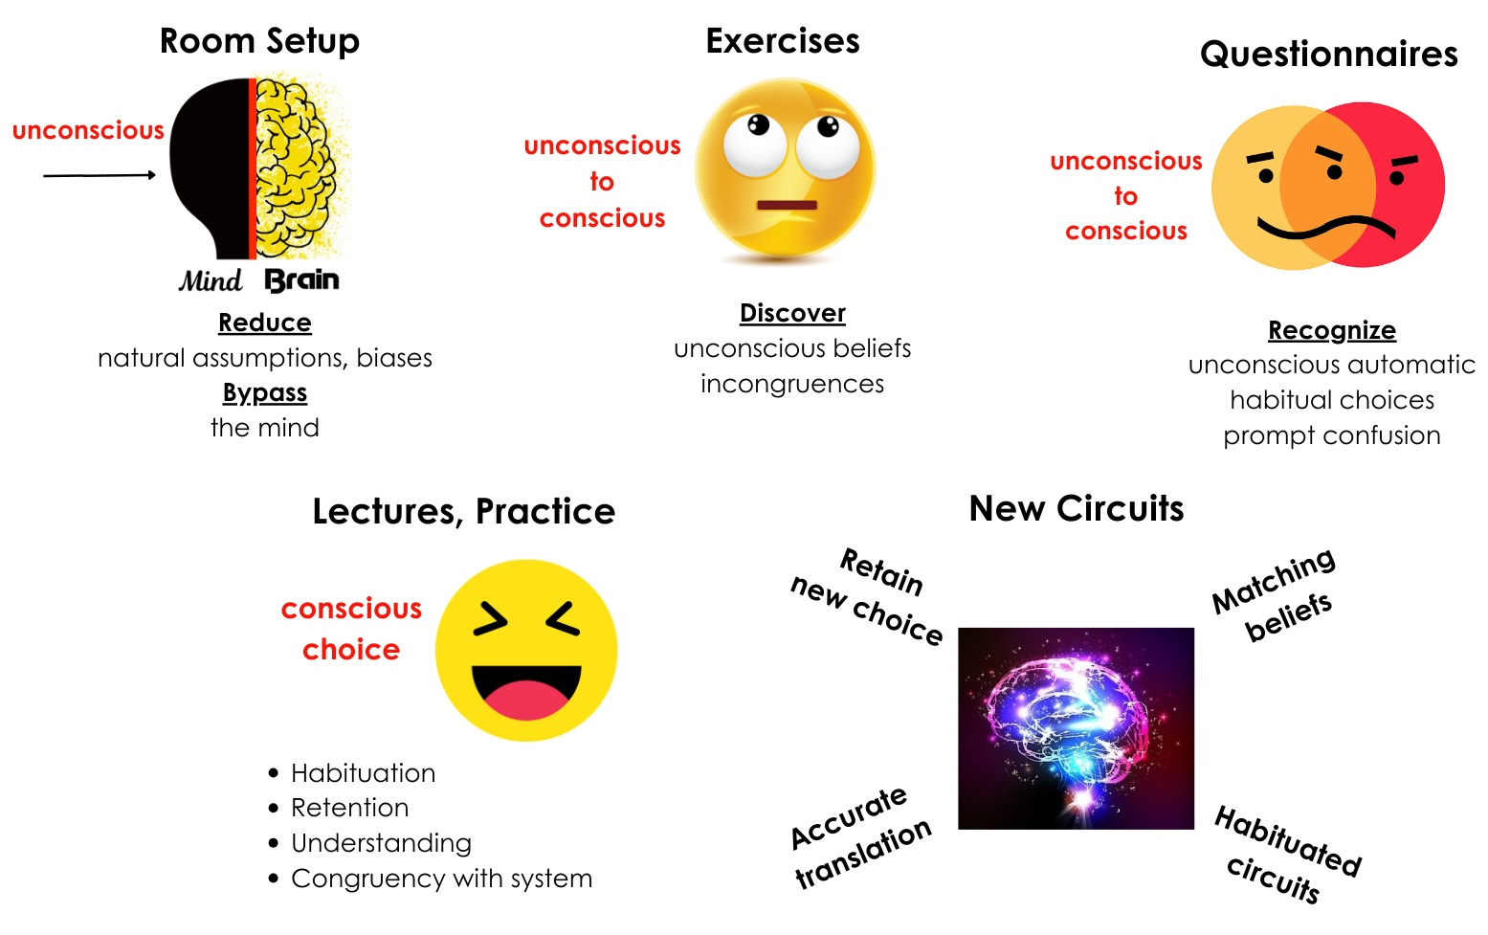
Learning Facilitation
©Sharon Drew Morgen 2024

Slide 18

Contact
SHARON-DREW MORGEN
sharondrew@sharondrewmorgen.com
www.sharon-drew.com
www.mind-brainconnection.com
512 771 1117
©Sharon Drew Morgen 2024

